Slide 1
Introduction to I2C and SPI both in-kernel and in user space.
Michael Welling
Founder
QWERTY Embedded Design, LLC
#lfelc
@QwertyEmbedded

Slide 2
I2C Overview
What is I2C?
Example I2C Devices
I2C Protocol
Linux I2C Subsystem
Linux I2C Drivers
I2C Bus Drivers
I2C Device Drivers
I2C Slave Interface
Instantiating I2C Devices
User space tools
Demo

Slide 3
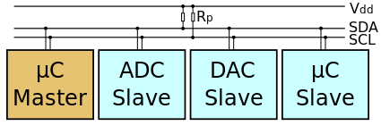
What is I2C?
I²C stands for inter-integrated circuit
First developed by Philips Semiconductor in 1982, currently owned by NXP Semiconductors
Synchronous multi-master multi-slave serial bus
Half duplex protocol
Open-drain signaling
Only two signal wires
SDA: serial data
SCL: serial clock
en:user:Cburnett, I2C, CC BY-SA 3.0
https://en.wikipedia.org/wiki/I%C2%B2C

Slide 4
What is I2C?
I²C addressing is typically 7 bits per the original specification
I²C clock speed is typically 100KHz per the original specification
Later versions of the specification introduced faster clock modes and 10 bit addressing
Version 1 added 400KHz Fast mode and 10 bit addressing
Version 2 added 3.4MHz Hs mode
Version 3 added 1MHz Fast mode+ and ID mechanism
Version 4 added unidirectional 5Mhz Ultra Fast mode

Slide 5
What is I2C?
SMBus (System Management Bus) is a subset of I²C defined by Intel
Typically used on PC motherboards for power control and sensors
Stricter tolerances on voltage levels and timing
Adds an optional software level address resolution protocol

Slide 6
Example I2C Devices
Real time clock
EEPROM
Analog converters (ADC, DAC)
Sensors (Temperature, Pressure)
Microcontrollers
Touchscreen controllers
GPIO expanders
Monitor and TV adapters

Slide 7
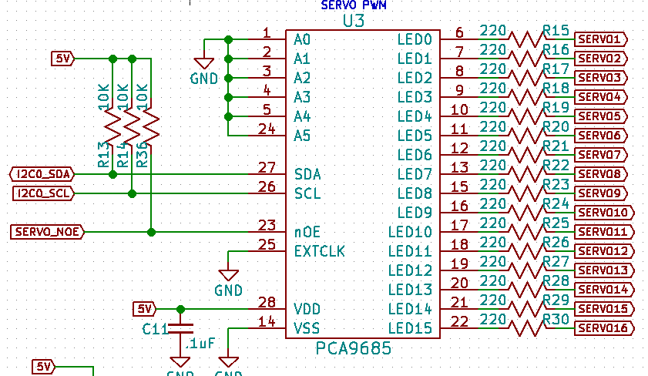
Example I2C Hardware

Slide 8
I2C Protocol
Start
SDA goes low before SCL to signal the start of transmission.
Addr
7 bit address that determines the slave device to be accessed.
R/W
Transaction data direction bit. (1 = read, 0 = write)
Data
Byte data read from or written to the slave device. Can be multiple bytes.
ACK
Acknowledge bit. (0 = ack, 1 = nak)
Stop SDA goes high after SCL to signal the end of transmission.

Slide 9
Linux I2C Subsystem
Early implementations were from Gerd Knorr and Simon G. Vogl.
Migrated to the device model by Greg KH in late 2.5 versions of Linux.
Integrated into standard device driver model by David Brownell and Jean Delvare in Linux 2.6.
Currently maintained by Wolfram Sang.

Slide 10
Linux I2C Subsystem
https://i2c.wiki.kernel.org

Slide 11
Linux I2C Subsystem
List: linux-i2c; ( subscribe / unsubscribe )
Info:
Linux kernel I2C bus layer mailing list.
Archives:
http://marc.info/?l=linux-i2c
http://www.spinics.net/lists/linux-i2c/

Slide 12
Linux I2C Drivers
I2C Bus Drivers
Bus → Algorithm
Adapter
An Algorithm driver contains general code that can be used for a whole class of I2C adapters. Each specific adapter driver either depends on one algorithm driver, or includes its own implementation.
https://www.kernel.org/doc/Documentation/i2c/summary

Slide 13
Linux I2C Drivers
I2C Bus Driver
Define and allocate a private data struct (contains struct i2c_adapter)
Fill algorithm struct
.master_xfer() – function to perform transfer
.functionality() – function to retrieve bus functionality.
Fill adaptor struct
i2c_set_adapdata()
.algo – pointer to algorithm struct
.algo_data – pointer the private data struct
Add adapter
i2c_add_adapter()

Slide 14
Linux I2C Drivers
I2C Device Drivers
Device → Driver
Client
A Driver driver (yes, this sounds ridiculous, sorry) contains the general code to access some type of device. Each detected device gets its own data in the Client structure. Usually, Driver and Client are more closely integrated than Algorithm and Adapter.
https://www.kernel.org/doc/Documentation/i2c/summary

Slide 15
Linux I2C Drivers
I2C Device Driver
i2c_driver
static struct i2c_driver foo_driver = {
.driver = {
.name = "foobar",
.of_match_table = of_match_ptr(foo_dt_ids)
},
.id_table = foo_idtable,
.probe = foo_probe,
.remove = foo_remove,
};

Slide 16
Linux I2C Drivers
I2C Device Driver
i2c_device_id / of_device_id
static struct i2c_device_id foo_idtable[] = {
{ "foo", 0 },
{ }
};
MODULE_DEVICE_TABLE(i2c, foo_idtable);
static const struct of_device_id foo_dt_ids[] = {
{ .compatible = "foo,bar", .data = (void *) 0xDEADBEEF },
{ }
};
MODULE_DEVICE_TABLE(of, foo_dt_ids);

Slide 17
Linux I2C Drivers
I2C Device Driver
Probe function
static int foo_probe(struct i2c_client *client, const struct i2c_device_id *id)
{
int ret;
pr_info("foo_probe called\n");
if (client->dev.of_node) {
pr_info("device tree instantiated probe. data = %x\n",
(unsigned int)of_device_get_match_data(&client->dev));
}
ret = i2c_smbus_read_byte_data(client, 0x0d);
pr_info("i2c read byte = %x\n", ret);
if (ret < 0)
return ret;
return 0;
}

Slide 18
Linux I2C Drivers
I2C Device Driver
Remove function
static int foo_remove(struct i2c_client *client)
{
/* do any cleanup here*/
pr_info("foo_remove called\n");
return 0;
}

Slide 19
Linux I2C Drivers
Each client structure has a special data field that can point to any structure at all. You should use this to keep device-specific data.
I2C Device Driver
Client data
Each client structure has a special data field that can point to any structure at all. You should use this to keep device-specific data.
/* store the value */
void i2c_set_clientdata(struct i2c_client *client, void *data);
/* retrieve the value */
void *i2c_get_clientdata(const struct i2c_client *client);

Slide 20
Linux I2C Drivers
I2C Device Driver
Initializing the driver
static int __init foo_init(void)
{
return i2c_add_driver(&foo_driver);
}
module_init(foo_init);
static void __exit foo_cleanup(void)
{
i2c_del_driver(&foo_driver);
}
module_exit(foo_cleanup);
The module_i2c_driver() macro can be used to reduce above code.
module_i2c_driver(foo_driver);

Slide 21
Linux I2C Drivers
I2C Device Driver
Plain I2C API
int i2c_master_send(struct i2c_client *client, const char *buf,
int count);
int i2c_master_recv(struct i2c_client *client, char *buf, int count);
These routines read and write some bytes from/to a client. The client contains the I2C address, so you do not have to include it. The second parameter contains the bytes to read/write, the third the number of bytes to read/write (must be less than the length of the buffer, also should be less than 64k since msg.len is u16.) Returned is the actual number of bytes read/written.
int i2c_transfer(struct i2c_adapter *adap, struct i2c_msg *msg,
int num);
This sends a series of messages. Each message can be a read or write, and they can be mixed in any way. The transactions are combined: no stop condition is issued between transaction. The i2c_msg structure contains for each message the client address, the number of bytes of the message and the message data itself.

Slide 22
Linux I2C Drivers
I2C Device Driver
SMBus I2C API
s32 i2c_smbus_read_byte(struct i2c_client *client);
s32 i2c_smbus_write_byte(struct i2c_client *client, u8 value);
s32 i2c_smbus_read_byte_data(struct i2c_client *client, u8 command);
s32 i2c_smbus_write_byte_data(struct i2c_client *client,
u8 command, u8 value);
s32 i2c_smbus_read_word_data(struct i2c_client *client, u8 command);
s32 i2c_smbus_write_word_data(struct i2c_client *client,
u8 command, u16 value);
s32 i2c_smbus_read_block_data(struct i2c_client *client,
u8 command, u8 *values);
s32 i2c_smbus_write_block_data(struct i2c_client *client,
u8 command, u8 length, const u8 *values);
s32 i2c_smbus_read_i2c_block_data(struct i2c_client *client,
u8 command, u8 length, u8 *values);
s32 i2c_smbus_write_i2c_block_data(struct i2c_client *client,
u8 command, u8 length,
const u8 *values);

Slide 23
Linux I2C Drivers
I2C Slave Interface
.
e.g. sysfs I2C slave events I/O registers
+-----------+ v +---------+ v +--------+ v +------------+
| Userspace +........+ Backend +-----------+ Driver +-----+ Controller |
+-----------+ +---------+ +--------+ +------------+
| |
----------------------------------------------------------------+-- I2C
--------------------------------------------------------------+---- Bus
echo slave-24c02 0x1064 > /sys/bus/i2c/devices/i2c-1/new_device
https://www.kernel.org/doc/Documentation/i2c/slave-interface

Slide 24
Instantiating I2C Devices
Device tree
i2c1: i2c@400a0000 {
/* ... master properties skipped ... */
clock-frequency = <100000>;
flash@50 {
compatible = "atmel,24c256";
reg = <0x50>;
};
pca9532: gpio@60 {
compatible = "nxp,pca9532";
gpio-controller;
#gpio-cells = <2>;
reg = <0x60>;
};
};

Slide 25
Instantiating I2C Devices
Platform device
static struct i2c_board_info h4_i2c_board_info[] __initdata = {
{
I2C_BOARD_INFO("isp1301_omap", 0x2d),
.irq = OMAP_GPIO_IRQ(125),
},
{ /* EEPROM on mainboard */
I2C_BOARD_INFO("24c01", 0x52),
.platform_data = &m24c01,
},
{ /* EEPROM on cpu card */
I2C_BOARD_INFO("24c01", 0x57),
.platform_data = &m24c01,
},
};
static void __init omap_h4_init(void)
{
(...)
i2c_register_board_info(1, h4_i2c_board_info,
ARRAY_SIZE(h4_i2c_board_info));
(...)
}

Slide 26
Instantiating I2C Devices
From user space
echo eeprom 0x50 > /sys/bus/i2c/devices/i2c-3/new_device
https://www.kernel.org/doc/Documentation/i2c/instantiating-devices

Slide 27
User space Tools
Simple character device driver (i2c-dev)
Device nodes at /dev/i2c-x
Slave address set by I2C_SLAVE ioctl.
Simple access using read() / write()
i2c_smbus_{read,write}_{byte,word}_data()
i2ctools
i2cdetect
i2cget
I2cset
https://www.kernel.org/doc/Documentation/i2c/dev-interface

Slide 28
User space Tools
From the Linux user space, you can access the I2C bus from the /dev/i2c-* device files.
debian@beaglebone:~$ ls -l /dev/i2c-*
crw-rw---- 1 root i2c 89, 0 Oct 7 16:40 /dev/i2c-0
crw-rw---- 1 root i2c 89, 1 Oct 7 16:40 /dev/i2c-1
crw-rw---- 1 root i2c 89, 2 Oct 7 16:40 /dev/i2c-2

Slide 29
User space Tools
List I2C devices on the bus
debian@beaglebone:~$ i2cdetect -y -r 2
0 1 2 3 4 5 6 7 8 9 a b c d e f
00: -- -- -- -- -- -- -- -- -- -- -- -- --
10: -- -- -- -- -- -- -- -- -- -- -- -- 1c -- -- --
20: -- -- -- -- -- -- -- -- -- -- -- -- -- -- -- --
30: -- -- -- -- -- -- -- -- -- -- -- -- -- -- -- --
40: -- -- -- -- -- -- -- -- -- -- -- -- -- -- -- --
50: -- -- -- -- -- -- -- -- -- -- -- -- -- -- -- --
60: -- -- -- -- -- -- -- -- -- -- -- -- -- -- -- --
70: -- -- -- -- -- -- -- --

Slide 30
User space Tools
Dump the register contents of MMA8453
debian@beaglebone:~$ i2cdump -y -r 0x00-0x31 2 0x1c
No size specified (using byte-data access)
0 1 2 3 4 5 6 7 8 9 a b c d e f 0123456789abcdef
00: ff fe 00 01 80 41 80 00 00 00 00 01 00 3a 00 00 .?.??A?....?.:..
10: 00 80 00 44 84 00 00 00 00 00 00 00 00 00 00 00 .?.D?...........
20: 00 00 00 00 00 00 00 00 00 00 01 00 00 00 00 00 ..........?.....
30: 00 00

Slide 31
User space Tools
Read and write single registers of the MMA8453
debian@beaglebone:~$ i2cget -y 2 0x1c 0x0d
0x3a
debian@beaglebone:~$ i2cget -y 2 0x1c 0x2a
0x00
debian@beaglebone:~$ i2cset -y 2 0x1c 0x2a 0x01
debian@beaglebone:~$ i2cget -y 2 0x1c 0x2a
0x01

Slide 32
Demo

Slide 33
SPI Overview
What is SPI?
Example SPI Devices
SPI Modes
Linux SPI Subsystem
Linux SPI Drivers
Controller Drivers
Protocol Drivers
Kernel APIs
Instantiating SPI Devices
User space tools
Demo

Slide 34
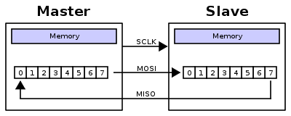
What is SPI?
SPI (Serial Peripheral Interface) is a full duplex synchronous serial master/slave bus interface
De facto standard first developed at Motorola in the 1980s
A SPI bus consists of a single master device and possibly multiple slave devices
Typical device interface
SCLK – serial clock
MISO – master in slave out
MOSI – master out slave in
CSn / SSn – chip select / slave select
IRQ / IRQn – interrupt
en:user:Cburnett, SPI, CC BY-SA 3.0

Slide 35
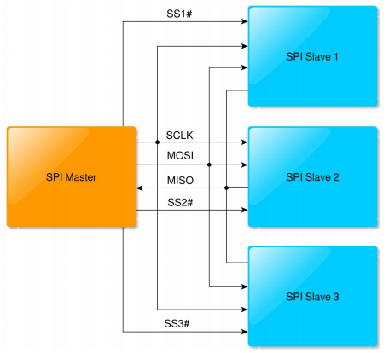
What is SPI?

Slide 36
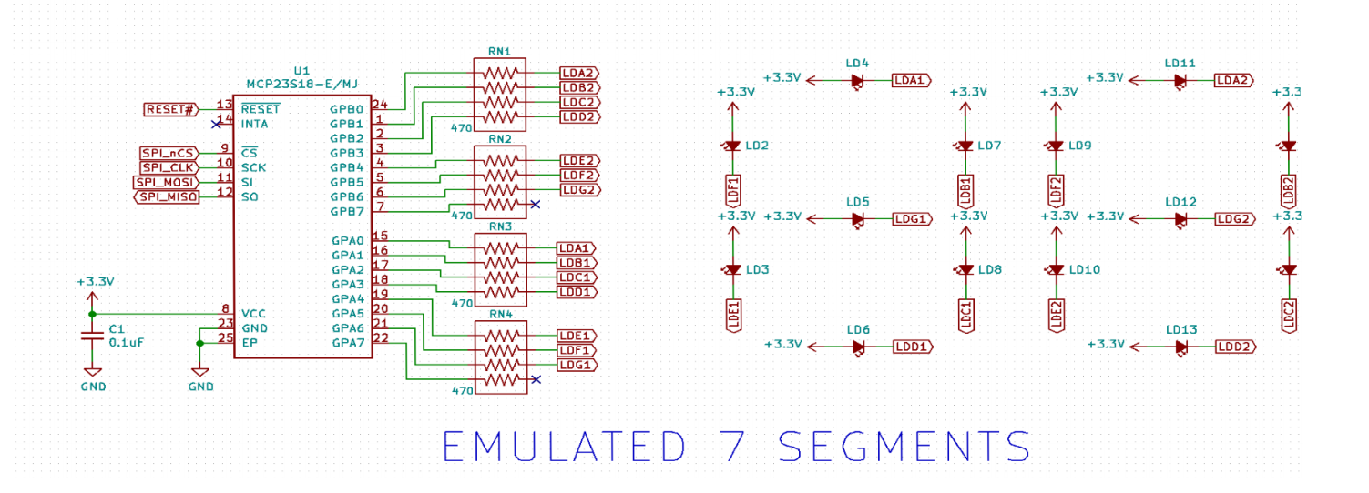
Example SPI devices
Analog converters (ADC, DAC, CDC)
Sensors (inertial, temperature, pressure)
Serial LCD
Serial Flash
Touchscreen controllers
FPGA programming interface

Slide 37
SPI Modes
SPI Mode is typically represented by (CPOL, CPHA) tuple
CPOL – clock polarity
0 = clock idles low
1 = clock idles high
CPHA – clock phase
0 = data latched on falling clock edge, output on rising
1 = data latched on rising clock edge, output on falling
Mode (0, 0) and (1, 1) are most commonly used
Sometimes listed in encoded form 0-3

Slide 38
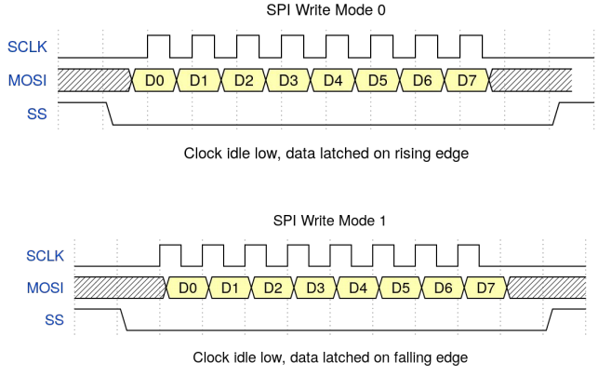
SPI Modes
SPI Mode Timing – CPOL = 0

Slide 39
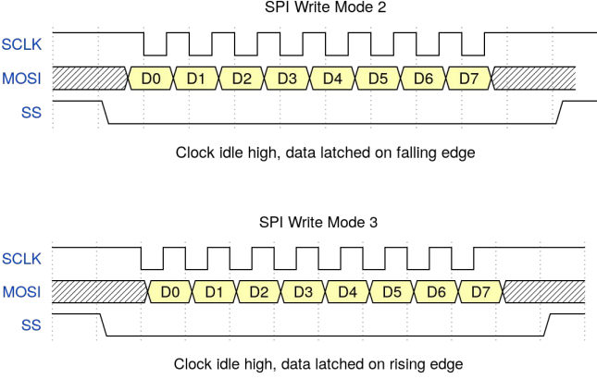
SPI Modes
SPI Mode Timing – CPOL = 1

Slide 40
Linux SPI Subsystem
First developed in early 2000s (2.6 ERA) based on the work of several key developers in including:
David Brownell
Russell King
Dmitry Pervushin
Stephen Street
Mark Underwood
Andrew Victor
Vitaly Wool

Slide 41
Linux SPI Subsystem
Past maintainers of the Linux SPI subsystem:
David Brownell
Grant Likely
Current maintainer:
Mark Brown

Slide 42
Linux SPI Subsystem
List: linux-spi; ( subscribe / unsubscribe )
Info:
This is the mailing list for the Linux SPI subsystem. Archives: http://marc.info/?l=linux-spi

Slide 43
Linux SPI Drivers
Controller Drivers
Controller drivers are used to abstract and drive transactions on an SPI master.
The host SPI peripheral registers are accessed by callbacks provided to the SPI core driver. (drivers/spi/spi.c)
struct spi_controller

Slide 44
Linux SPI Drivers
Controller Drivers
Allocate a controller
spi_alloc_master()
Set controller fields and methods
mode_bits - flags e.g. SPI_CPOL, SPI_CPHA, SPI_NO_CS, SPI_CS_HIGH, SPI_RX_QUAD, SPI_LOOP
.setup() - configure SPI parameters
.cleanup() - prepare for driver removal
.transfer_one_message()/.transfer_one() - dispatch one msg/transfer (mutually exclusive)
Register a controller
spi_register_master()

Slide 45
Linux SPI Drivers
Controller Devicetree Binding
The SPI controller node requires the following properties:
compatible - Name of SPI bus controller following generic names recommended practice.
In master mode, the SPI controller node requires the following additional properties:
#address-cells - number of cells required to define a chip select address on the SPI bus.
#size-cells - should be zero.
Optional properties (master mode only):
cs-gpios - gpios chip select.
num-cs - total number of chipselects.
So if for example the controller has 2 CS lines, and the cs-gpios property looks like this:
cs-gpios = <&gpio1 0 0>, <0> , <&gpio1 1 0>, <&gpio1 2 0>;

Slide 46
Linux SPI Drivers
Controller Devicetree Binding
Example:
spi1: spi@481a0000 {
compatible = "ti,omap4-mcspi";
#address-cells = <1>;
#size-cells = <0>;
reg = <0x481a0000 0x400>;
interrupts = <125>;
ti,spi-num-cs = <2>;
ti,hwmods = "spi1";
dmas = <&edma 42 0
&edma 43 0
&edma 44 0
&edma 45 0>;
dma-names = "tx0", "rx0", "tx1", "rx1";
status = "disabled";
};

Slide 47
Linux SPI Drivers
Protocol Drivers
For each SPI slave you intend on accessing, you have a protocol driver. SPI protocol drivers can be found in many Linux driver subsystems (iio, input, mtd).
Messages and transfers are used to communicate to slave devices via the SPI core and are directed to the respective controller driver transparently.
A struct spi_device is passed to the probe and remove functions to pass information about the host.

Slide 48
Linux SPI Drivers
Protocol Drivers
Transfers
A single operation between master and slave
RX and TX buffers pointers are supplied
Option chip select behavior and delays
Messages
Atomic sequence of transfers
Argument to SPI subsystem read/write APIs

Slide 49
Linux SPI Drivers
Protocol Drivers
struct spi_device
struct spi_device {
struct device dev;
struct spi_controller * controller;
struct spi_controller * master;
u32 max_speed_hz;
u8 chip_select;
u8 bits_per_word;
u16 mode;
int irq;
void * controller_state;
void * controller_data;
char modalias;
int cs_gpio;
struct spi_statistics statistics;
}
Controller side proxy for an SPI slave device. Passed to the probe and remove functions with values based on the host configuration.

Slide 50
Linux SPI Drivers
Protocol Drivers
#define SPI_CPHA 0x01 /* clock phase */
#define SPI_CPOL 0x02 /* clock polarity */
#define SPI_MODE_0 (0|0) /* (original MicroWire) */
#define SPI_MODE_1 (0|SPI_CPHA)
#define SPI_MODE_2 (SPI_CPOL|0)
#define SPI_MODE_3 (SPI_CPOL|SPI_CPHA)
#define SPI_CS_HIGH 0x04 /* chipselect active high? */
#define SPI_LSB_FIRST 0x08 /* per-word bits-on-wire */
#define SPI_3WIRE 0x10 /* SI/SO signals shared */
#define SPI_LOOP 0x20 /* loopback mode */
#define SPI_NO_CS 0x40 /* 1 dev/bus, no chipselect */
#define SPI_READY 0x80 /* slave pulls low to pause */
#define SPI_TX_DUAL 0x100 /* transmit with 2 wires */
#define SPI_TX_QUAD 0x200 /* transmit with 4 wires */
#define SPI_RX_DUAL 0x400 /* receive with 2 wires */
#define SPI_RX_QUAD 0x800 /* receive with 4 wires */

Slide 51
Linux SPI Drivers
Protocol Drivers
Probe Function
static int myspi_probe(struct spi_device *spi)
{
struct myspi *chip;
struct myspi_platform_data *pdata, local_pdata;
...
}

Slide 52
Linux SPI Drivers
Protocol Drivers
Probe Function
static int myspi_probe(struct spi_device *spi)
{
...
match = of_match_device(of_match_ptr(myspi_of_match), &spi->dev);
if (match) {
/* parse device tree options */
pdata = &local_pdata;
...
}
else {
/* use platform data */
pdata = &spi->dev.platform_data;
if (!pdata)
return -ENODEV;
}
...
}

Slide 53
Linux SPI Drivers
Protocol Drivers
Probe Function
static int myspi_probe(struct spi_device *spi)
{
...
/* get memory for driver's per-chip state */
chip = devm_kzalloc(&spi->dev, sizeof *chip, GFP_KERNEL);
if (!chip)
return -ENOMEM;
spi_set_drvdata(spi, chip);
...
return 0;
}

Slide 54
Linux SPI Drivers
Protocol Drivers
OF Device Table
Example:
static const struct of_device_id myspi_of_match[] = {
{
.compatible = "mycompany,myspi",
.data = (void *) MYSPI_DATA,
},
{ },
};
MODULE_DEVICE_TABLE(of, myspi_of_match);

Slide 55
Linux SPI Drivers
Protocol Drivers
SPI Device Table
Example:
static const struct spi_device_id myspi_id_table[] = {
{ "myspi", MYSPI_TYPE },
{ },
};
MODULE_DEVICE_TABLE(spi, myspi_id_table);

Slide 56
Linux SPI Drivers
Protocol Drivers
struct spi_driver
struct spi_driver {
const struct spi_device_id * id_table;
int (* probe) (struct spi_device *spi);
int (* remove) (struct spi_device *spi);
void (* shutdown) (struct spi_device *spi);
struct device_driver driver;
};

Slide 57
Linux SPI Drivers
Protocol Drivers
struct spi_driver
Example:
static struct spi_driver myspi_driver = {
.driver = {
.name = "myspi_spi",
.pm = &myspi_pm_ops,
.of_match_table = of_match_ptr(myspi_of_match),
},
.probe = myspi_probe,
.id_table = myspi_id_table,
};
module_spi_driver(myspi_driver);

Slide 58
Linux SPI Drivers
Protocol Drivers
Kernel APIs
spi_async()
asynchronous message request
callback executed upon message complete
can be issued in any context
spi_sync()
synchronous message request
may only be issued in a context that can sleep (i.e. not in IRQ context)
wrapper around spi_async()
spi_write()/spi_read()
helper functions wrapping spi_sync()

Slide 59
Linux SPI Drivers
Protocol Drivers
Kernel APIs
spi_read_flash()
Optimized call for SPI flash commands
Supports controllers that translate MMIO accesses into standard SPI flash commands
spi_message_init()
Initialize empty message
spi_message_add_tail()
Add transfers to the message’s transfer list

Slide 60
Linux SPI Drivers
Instantiating SPI Devices
Slave Node Devicetree Binding
SPI slave nodes must be children of the SPI controller node.
In master mode, one or more slave nodes (up to the number of chip selects) can
be present.
Required properties are:
- compatible - Name of SPI device following generic names recommended practice.
- reg - Chip select address of device.
- spi-max-frequency - Maximum SPI clocking speed of device in Hz.

Slide 61
Linux SPI Drivers
Instantiating SPI Devices
Slave Node Devicetree Binding
All slave nodes can contain the following optional properties:
- spi-cpol - Empty property indicating device requires inverse clock polarity (CPOL) mode.
- spi-cpha - Empty property indicating device requires shifted clock phase (CPHA) mode.
- spi-cs-high - Empty property indicating device requires chip select active high.
- spi-3wire - Empty property indicating device requires 3-wire mode.
- spi-lsb-first - Empty property indicating device requires LSB first mode.
- spi-tx-bus-width - The bus width that is used for MOSI. Defaults to 1 if not present.
- spi-rx-bus-width - The bus width that is used for MISO. Defaults to 1 if not present.
- spi-rx-delay-us - Microsecond delay after a read transfer.
- spi-tx-delay-us - Microsecond delay after a write transfer

Slide 62
Linux SPI Drivers
Instantiating SPI Devices
Slave Node Devicetree Binding
Example:
&spi1 {
#address-cells = <1>;
#size-cells = <0>;
status = "okay";
pinctrl-names = "default";
pinctrl-0 = <&spi1_pins>;
myspi@0 {
compatible = "mycompany,myspi";
spi-max-frequency = <2000000>;
spi-cpha;
...
reg = <0>;
};
...
};

Slide 63
Linux SPI Drivers
Instantiating SPI Devices
Platform Registration
struct spi_board_info {
char modalias;
const void * platform_data;
const struct property_entry * properties;
void * controller_data;
int irq;
u32 max_speed_hz;
u16 bus_num;
u16 chip_select;
u16 mode;
};

Slide 64
Linux SPI Drivers
Instantiating SPI Devices
Platform Registration
Example:
static struct spi_board_info myspi_board_info[] = {
{
.modalias = "myspi",
.platform_data = &myspi_info,
.irq = MYIRQ,
.max_speed_hz = 2000000,
.chip_select = 2,
…..
},
};

Slide 65
Linux SPI Drivers
User space tools
spidev
What does spidev do?
Passes data between user space and SPI controller
Collects buffers for TX/RX from user space application
Hands off buffers to SPI controller driver
Returns to user space when transfer is complete

Slide 66
Linux SPI Drivers
User space tools
spidev
When should spidev be used?
Prototyping in an environment that's not crash-prone; stray pointers in user space won't normally bring down any Linux system.
Developing simple protocols used to talk to microcontrollers acting as SPI slaves, which you may need to change quite often.
https://www.kernel.org/doc/Documentation/spi/spidev

Slide 67
Linux SPI Drivers
User space tools
spidev
When should spidev NOT be used?
Of course there are drivers that can never be written in user space, because they need to access kernel interfaces (such as IRQ handlers or other layers of the driver stack) that are not accessible to user space.
https://www.kernel.org/doc/Documentation/spi/spidev

Slide 68
Linux SPI Drivers
User space tools
spidev
SPI devices have a limited user space API, supporting basic half-duplex read() and write() access to SPI slave devices. Using ioctl() requests, full duplex transfers and device I/O configuration are also available.
Required header files:
#include <fcntl.h>
#include <unistd.h>
#include <sys/ioctl.h>
#include <linux/types.h>
#include <linux/spi/spidev.h>

Slide 69
Linux SPI Drivers
User space tools
spidev
The sysfs node for the SPI device will include a child device node with a “dev” attribute that will be understood by udev or mdev.
For a SPI device with chip select C on bus B, you should see:
/dev/spidevB.C - character special device, major number 153 with a dynamically chosen minor device number.
/sys/devices/…/spiB.C - SPI device node will be a child of its SPI master controller.
/sys/class/spidev/spidevB.C - created when the “spidev” driver binds to that device.

Slide 70
Linux SPI Drivers
User space tools
spidev
Normal open() and close() operations on /dev/spidevB.D files work as you would expect.
Standard read() and write() operations are obviously only half-duplex, and the chipselect is deactivated between those operations.
Full-duplex access, and composite operation without chipselect de-activation, is available using the SPI_IOC_MESSAGE(N) request.

Slide 71
Linux SPI Drivers
User space tools
spidev ioctl
Several ioctl() requests let your driver read or override the device’s current settings for data transfer parameters:
SPI_IOC_RD_MODE, SPI_IOC_WR_MODE
Pass a pointer to a byte which will return (RD) or assign (WR) the SPI transfer mode. Use the constants SPI_MODE_0..SPI_MODE_3; or if you prefer you can combine SPI_CPOL (clock polarity, idle high iff this is set) or SPI_CPHA (clock phase, sample on trailing edge iff this is set) flags. Note that this request is limited to SPI mode flags that fit in a single byte.
SPI_IOC_RD_MODE32, SPI_IOC_WR_MODE32
Pass a pointer to a uin32_t which will return (RD) or assign (WR) the full SPI transfer mode, not limited to the bits that fit in one byte.

Slide 72
Linux SPI Drivers
User space tools
spidev ioctl
SPI_IOC_RD_LSB_FIRST, SPI_IOC_WR_LSB_FIRST
Pass a pointer to a byte which will return (RD) or assign (WR) the bit justification used to transfer SPI words. Zero indicates MSB-first; other values indicate the less common LSB-first encoding. In both cases the specified value is right-justified in each word, so that unused (TX) or undefined (RX) bits are in the MSBs.
SPI_IOC_RD_BITS_PER_WORD, SPI_IOC_WR_BITS_PER_WORD
Pass a pointer to a byte which will return (RD) or assign (WR) the number of bits in each SPI transfer word. The value zero signifies eight bits.
SPI_IOC_RD_MAX_SPEED_HZ, SPI_IOC_WR_MAX_SPEED_HZ
Pass a pointer to a u32 which will return (RD) or assign (WR) the maximum SPI transfer speed, in Hz. The controller can’t necessarily assign that specific clock speed.

Slide 73
Linux SPI Drivers
User space tools
spidev
__u8 miso[MAX_LENGTH];
__u8 mosi[MAX_LENGTH];
struct spi_ioc_transfer tr = {
.tx_buf = (unsigned long)mosi,
.rx_buf = (unsigned long)miso,
.delay_usecs = 1,
.len = 1,
};
…
fd = open(device_name, O_RDWR);
…
ret = ioctl(fd, SPI_IOC_MESSAGE(1), &tr);
https://github.com/mwelling/spi-test/

Slide 74
Demo

Slide 75
Questions?

