Slide 1
Introduction to NFTables
Mike Anderson
Director of Technology
The PTR Group, LLC

Slide 2
Speaker/Author Details
Website:
http://www.theptrgroup.com
Email:
mailto:mike@theptrgroup.com
Linked-in:
https://www.linkedin.com/in/mikeandersonptr
Twitter:
@hungjar
PTR is now a subsidiary of

Slide 3
What We Will Talk About…
Linux packet handling hooks in the stack
Stateless and stateful firewalls
Connection tracking
Xtables packet flow
nftables architecture
Installation in kernel and userspace
Approach and usage
Converting existing Xtables firewalls to nftables
Finding documentation
Summary

Slide 4
Understanding Network Traffic Terms
Application layer L5+
L4
L3
Routing
L2 (MAC)
Bridging
L1
Ingress
Forward
Egress
The paths taken in the stack by network frames differ for the inbound (ingress), routed/bridged and outbound (egress) data streams
There are multiple decision points along the way that determine the fate and path of network frames
These include the potential of simply dropping the packet at several decision points

Slide 5
Hooks Within the Stack
Higher layers Local Processes
NF_IP_LOCAL_IN (iptables: INPUT)
NF_IP_LOCAL_OUT (iptables: OUTPUT)
iptables/ip6tables
Routing
NF_IP_FORWARD (iptables: FORWARD)
Routing
NF_IP_PRE_ROUTING
NF_IP_POST_ROUTING
NF_BR_LOCAL_IN
NF_BR_LOCAL_OUT
ebtables
NF_BR_PRE_ROUTING
NF_BR_FORWARD
NF_BR_POST_ROUTING
L3
CRC & Consistency Checks
L2
Device Driver (Input)
Device Driver (Output)

Slide 6
Example Hook Module
Here is an example of hooking in the stack to simply drop all UDP traffic
// ’Hello World’ v2 netfilter hooks example that drops UDP (protocol 17)
#include <linux/kernel.h>
#include <linux/module.h>
#include <linux/netfilter.h>
#include <linux/netfilter_ipv4.h>
#include <linux/skbuff.h>
#include <linux/udp.h>
#include <linux/ip.h>
static struct nf_hook_ops nfho; //net filter hook option struct
struct sk_buff *sock_buff;
struct udphdr *udp_header; //udp header struct (not used)
struct iphdr *ip_header; //ip header struct
int init_module() {
nfho.hook = hook_func;
nfho.hooknum = NF_IP_PRE_ROUTING;
nfho.pf = PF_INET;
nfho.priority = NF_IP_PRI_FIRST;
nf_register_hook(&nfho);
return 0;
}
(source http://www.paulkiddie.com)

Slide 7
Example Hook Module #2
unsigned int hook_func(unsigned int hooknum, struct sk_buff **skb, const struct net_device *in, const struct net_device *out, int (*okfn)(struct sk_buff *)) {
sock_buff = *skb;
// grab network header using accessor
ip_header = (struct iphdr *)skb_network_header(sock_buff);
if(!sock_buff) { return NF_ACCEPT;}
// grab transport header
if (ip_header->protocol==17) {
udp_header = (struct udphdr *)skb_transport_header(sock_buff); // log we’ve got udp packet to /var/log/messages
printk(KERN_INFO "got udp packet \n");
return NF_DROP;
}
return NF_ACCEPT;
}
void cleanup_module() {
nf_unregister_hook(&nfho);
}

Slide 8
Network Packet Filtering
Within each operating system with network connectivity, we must take into account the evil cyber wonks
They have nothing better to do with their time but attack the unsuspecting
Generally, the first layer of a defense-in-depth strategy is to try to block evil-doers with a packet filter
Drops/blocks packets before they can enter the network stack
Packet filters are typically stateless or stateful
Stateless filters are also known as network-layer firewalls
Stateful filters are also known as circuit-level firewalls
Source: youtube.com

Slide 9
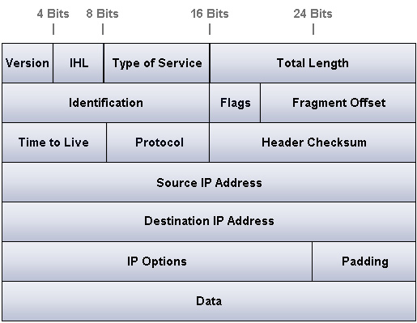
Packet Filters
Validates a packet based mostly on the contents of its IP header
IP Addresses
Protocol
Type of service
Hardware Interface
Direction
Each packet is an entity onto themselves
I.e., the filter is stateless
Little visibility into the packet payload/data
Packet filters *can* look into the TCP header
Typically only for the TCP/UDP port, however
Source: learn-networking.com

Slide 10
Well Known Port Examples
A Linux system has 65535 ports
Ports are bound using the bind() call for servers or automatically for clients
Not all are used
Modification of well-known ports (1-1023) requires superuser permissions
Reserved for privileged system processes
Source: certapps.com

Slide 11
Other Ports
Registered Ports (1024 -> 49151) are for applications that do not need superuser privileges
OpenVPN:1194
NFS: 2049
SVN: 3690
Ephemeral Ports (49152 -> 65535) are for applications that need a temporary communications port
Many Linux kernels use the port range (32768 -> 61000) for sockets

Slide 12
Problems With Port Blocking
FTP example
Client sends command from an arbitrary port to port 21 on the server
Server sends data from port 20 to the client on a dynamically allocated port
Depending on the firewall configuration (usually default deny) the dynamically-allocated port is probably blocked

Slide 13
Example Packet Filtering Rules
Packet filter behavior is defined by the use of rules
Policy/Rule | Firewall Setting
No outside Web access | Drop all outgoing packets to any IP address using port 80
Prevent IPTV from eating up the available bandwidth | Drop all incoming UDP packets except DNS and router broadcasts
Prevent your network from being used for a DoS attack | Drop all ICMP packets going to a 'broadcast' address (e.g. 222.22.255.255)
Prevent your network from being tracerouted | Drop all outgoing ICMP
Source: cis.poly.edu

Slide 14
Packet Filter Rule Definitions
Rules are processed from top to bottom until match is found
If no rule matches, the default policy is followed
Action | Source Address | Dest Address | Protocol | Source Port | Dest Port
Deny | 222.22/16 | outside of 222.22/16 | TCP | > 1023 | 80
Allow | outside of 222.22/16 | 222.22/16 | TCP | 80 | >1023
Allow | 222.22/16 | outside of 222.22/16 | UDP | >1023 | 53
Allow | outside of 222.22/16 | 222.22/16 | UDP | 53 | >1023
Deny | All | All | All | All | All
Source: cis.poly.edu

Slide 15
Stateless Filters: Pros & Cons
Advantages
Effective against worms and Trojan horses
Can be very fast if filtering rules are not too complex
Built into Linux kernel
Disadvantages
Does not protect against attacks with malformed packets (e.g., spoofing)
Does not protect against protocol-based attacks (e.g., buffer overflows)
Not effective against attacks using authorized channels (e.g., email viruses)
Cannot enforce some policies like excluding certain users
Rules can get complicated and difficult to test
Necessary but not sufficient
Packet filters are the first line of defense in a multi-layered approach

Slide 16
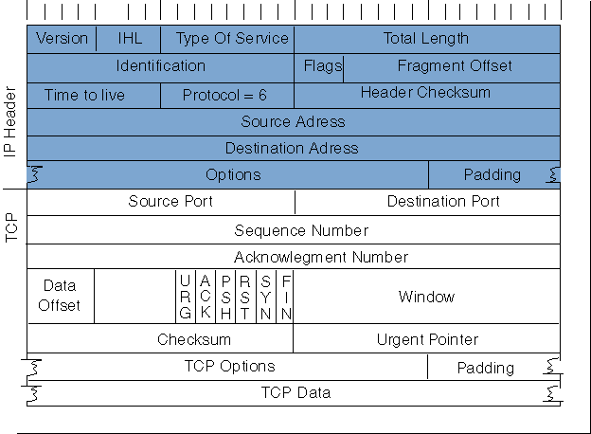
Stateful Filters
Extension of basic packet filters
Remembers the state of communication sessions
Using TCP header information, it permits connections only from trusted clients
Can configure to only allow in packets from established sessions
Source: cisco.com

Slide 17
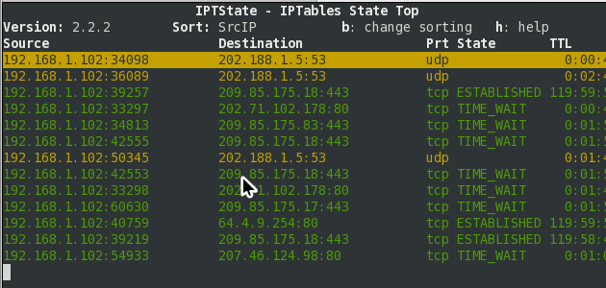
Connection State Table
Keeps a dynamic table of active sessions
Assigns connection states to each packet
NEW, ESTABLISHED, RELATED, INVALID
Linux uses the conntrack mechanism to maintain the connection table
Source: johnboy60.com

Slide 18
Stateful Filters: Pros & Cons
Advantages
Relatively easy to implement
Standard protocols are very easy to configure
Among the fastest filter types
Needs to check packet rules for connection requests (OSI layer 7)
Otherwise only needs to check state table (OSI layer 4 and below)
Protects against 'answer' session exploits and some DoS like SYN-flooding
Built into Linux kernel
Disadvantages
Does not protect against attacks with malformed packets (e.g., spoofing)
Does not protect against protocol-based attacks (e.g., buffer overflows)
Not effective against attacks using authorized channels (e.g., email viruses)

Slide 19
Bridging Firewalls and Brouters
At L2, Linux has another set of packet filtering code known as ebtables
Three separate tables: filter, NAT and broute
Often used for rewriting MAC addresses ala NAT
In the broute table, we decide to either bridge or route the packet by forwarding it to L3
DROP rule says to route the frame to L3 and ACCEPT rule says to bridge the frame

Slide 20
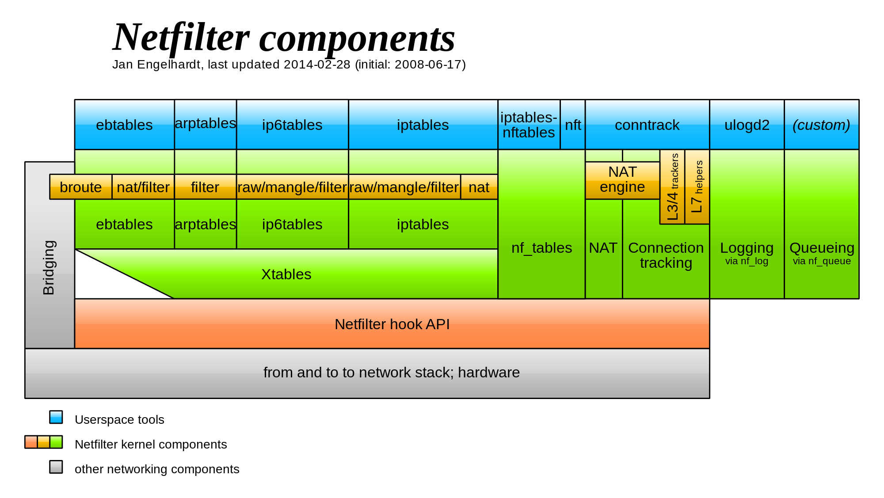
Netfilter Architecture
ebtables: Manages ruleset for Ethernet packet frames
arptables: Manages ruleset for ARP packet frames
iptables/ip6tables: iptables for IPv4 and IPv6 respectively
conntrack: Manage in-kernel connection state table
Source: wikipedia.org

Slide 21
Xtables Packet Flow
Source: inai.de

Slide 22
Problems with Xtables
The Xtables mechanism has been in use since the 2.4 kernel
Defining both stateless and stateful firewall rules can be tedious due to the number of rules that need to be written
The order of the rules is important
Any change to the rules require the entire table be reloaded
When being used on a multi-tenant server, the creation and searching of the rules for each client starts to slow exponentially as the number of rules increases
In addition, there is considerable duplicated code between the protocol stacks

Slide 23
Example of Dropping Malformed Packets
Source: linuxjournal.com
Deal with oddball packets $ iptables -A INPUT -i eth0 -p tcp -m tcp --tcp-flags FIN,SYN,RST,PSH,ACK,URG NONE -j DROP $ iptables -A INPUT -i eth0 -p tcp -m tcp --tcp-flags FIN,SYN FIN,SYN -j DROP $ iptables -A INPUT -i eth0 -p tcp -m tcp --tcp-flags SYN,RST SYN,RST -j DROP $ iptables -A INPUT -i eth0 -p tcp -m tcp --tcp-flags FIN,RST FIN,RST -j DROP $ iptables -A INPUT -i eth0 -p tcp -m tcp --tcp-flags FIN,ACK FIN -j DROP $ iptables -A INPUT -i eth0 -p tcp -m tcp --tcp-flags ACK,URG URG -j DROP
Source: typepad.com

Slide 24
Enter nftables
In 2009, the nftables project was created by Patrick McHardy to address the perceived problems of netfilter code duplication for each protocol and that of the Xtables mechanism slowing down packet handling
In the mean time, the ipset command was introduced to simplify the creation of efficient look-up tables for “sets” of addresses
Made it more efficient to match rules against large numbers of IP addresses like from a blacklist of evil IPs
nftables languished because it addressed a problem that had apparently already been solved
Then, in 2013, the nftables project was revived by Pablo Neira Ayuso and the code made it into mainline for the 3.13 kernel
Driven by the explosion of the use of containers and VMs which made the existing Xtables solutions untenable because large sets of rules would come and go rapidly
Source: nftables.org

Slide 25
nftables Architecture
In order to simplify all of the Xtables commands into a generic syntax with a common API and significantly reduce the amount of duplicated code, nftables borrows the interpreter VM concept from BPF
The VM in the kernel space runs bytecode compiled in userspace via the nft CLI
No separate APIs for iptables, ip6tables, arptables, ebtables, etc.
However, no predefined tables like iptables’ INPUT, OUTPUT, FORWARD, etc.
So, you have to essentially start from scratch each time the system starts
Uses the existing NF hooks and conntrack mechanism
Remains compatible with iptables via some translators
Arithmetic, bitwise and comparison operators can be used for deciding the fate of packets
Supports arbitrary offsets into packets for evaluations
Like Xtables, nftables are a sequence of Table->Chain->Rule tuples

Slide 26
Verify that nftables is in the Kernel
Because nftables is an alternative to Xtables, your kernel may not have nftables enabled
# lsmod | grep ^nf
<lots of modules beginning with nf>
It’s also possible that your kernel may have nft statically linked
Try to create a table and chain using:
# nft add table inet filter
# nft add chain inet filter input
If these succeed, then nftables is installed

Slide 27
Kernel Configuration

Slide 28
Usage
You will need to install the nftables and iptables-nftables-compat packages
You need the nft CLI and the iptables-to-nftables translators and their libraries
The nft CLI is both a compiler and decompiler of the bytecode to/from the kernel VM
Any changes made from the command line are transient and will be lost on the next reboot
Can be saved to a file and reloaded on the next reboot
i.e., if loaded from a file, these are considered “permanent”
The file /etc/nftables.conf is automatically loaded by systemd
There are commands that will take iptables/ip6tables commands and show the equivalent nftables command
Also, there are iptables syntax-compatible commands that use the nftables framework
E.g., iptables-compat, arptables-compat, ebtables-compat, etc.

Slide 29
Coexistance of Xtables and nftables
You can have both Xtables and nftables active simultaneously
Not recommended as this makes it nearly impossible to debug
To disable iptables/ip6tables, use:
# iptables –F; iptables –L
# ip6tables –F; ip6tables -L
To disable nftables, use:
# nft flush ruleset
Source: sfgate.com

Slide 30
Basic Approach
The sequence of tasks in nftables is to create a table(s), then chain(s), then rule(s)
Each command should include an address family
Defaults to the ip family if none specified
The address families are:
ip IPv4 address family
ip6 IPv6 address family
inet Internet (IPv4/IPv6) address family
arp ARP address family (IPv4 ARP packets)
bridge Bridge address family (L2)
netdev Netdev address family, handling packets from ingress

Slide 31
CLI vs. File
It is possible to enter all of the elements of the tables via the nft CLI
However, some of the options can be tricky to enter from the command line due to the shell’s line interpreter
# nft add chain ip traffic-filter output \
{ type filter hook output priority 0 \; policy accept\; }
Alternatively, you can put the commands into a formatted file and import the file using:
# nft –f <filename>

Slide 32
Sample IPv4/IPv6 Combined Firewall
#!/sbin/nft -f flush ruleset
table inet filter { chain input { type filter hook input priority 0; policy drop; ct state invalid counter drop comment "early drop of invalid packets" ct state {established, related} counter accept comment "accept all connections related to connections made by us" iif lo accept comment "accept loopback" iif != lo ip daddr 127.0.0.1/8 counter drop comment "drop connections to loopback not coming from loopback" iif != lo ip6 daddr ::1/128 counter drop comment "drop connections to loopback not coming from loopback" ip protocol icmp counter accept comment "accept all ICMP types" ip6 nexthdr icmpv6 counter accept comment "accept all ICMP types" tcp dport 22 counter accept comment "accept SSH" counter comment "count dropped packets" }
chain forward { type filter hook forward priority 0; policy drop; counter comment "count dropped packets" }
# If you're not counting packets, this chain can be omitted. chain output { type filter hook output priority 0; policy accept; counter comment "count accepted packets" } }
Source: cbronline.com

Slide 33
Example Bridge w/ Failed Translation
# ebtables-nft -L Bridge table: filter Bridge chain: INPUT, entries: 0, policy: ACCEPT Bridge chain: FORWARD, entries: 2, policy: ACCEPT --802_3-type 0x0001 -j CONTINUE --mark 0x1 -j CONTINUE Bridge chain: OUTPUT, entries: 0, policy: ACCEPT
# nft list ruleset table bridge filter { chain INPUT { type filter hook input priority -200; policy accept; } chain FORWARD { type filter hook forward priority -200; policy accept; #--802_3-type 0x0001 counter packets 0 bytes 0 #--mark 0x1 counter packets 0 bytes 0 }
chain OUTPUT { type filter hook output priority -200; policy accept; } }

Slide 34
Translating from iptables to nftables
It is possible to migrate your existing iptables firewalls to nftables using the following sequence:
# iptables-save > iptables.b4nft # iptables-restore-translate -f iptables.b4nft > ruleset.nft # nft -f ruleset.nft
Then, you can move these commands into the /etc/nftables.conf so systemd will load them at boot
You can also translate iptables commands one-by-one:
# iptables-translate -A INPUT -i eth0 -p tcp -m tcp \
--tcp-flags FIN,SYN,RST,PSH,ACK,URG NONE -j DROP nft add rule ip filter INPUT iifname eth0 tcp flags &\ (fin|syn|rst|psh|ack|urg) == 0x0 counter drop
Source: migrationboutique.com

Slide 35
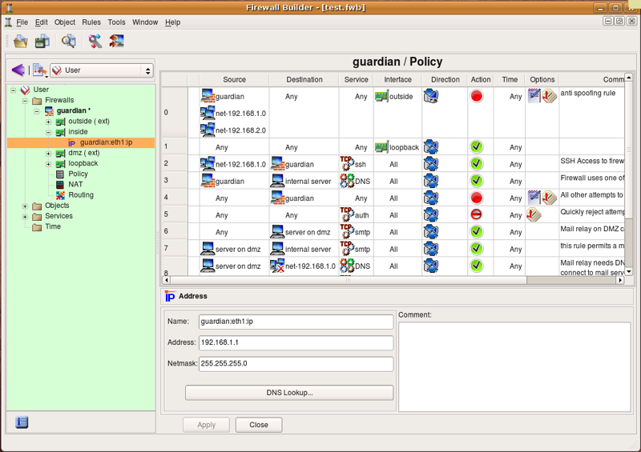
GUI Firewall Builder for nftables?
The syntax for nftables is relatively complex and not well documented
So, is there a GUI that outputs the rules in the correct format?
Well, sort of…
fwbuilder is used by Red Hat and claims to have output compatible with nftables
But, there’s nothing obvious in the GUI for nftables
And, any of the iptables-based firewall builders could output iptables commands that could be converted to nftables using the techniques presented earlier
Source: sourceforge.net

Slide 36
Finding Documentation
Unfortunately, there’s not a lot of documentation on nftables
The nftables HOWTO can be found here:
https://wiki.nftables.org/wiki-nftables/index.php/Main_Page
ArchLinux also has a wiki:
https://wiki.archlinux.org/index.php/Nftables
Fortunately, there’s also a book: Linux Firewalls: Enhancing Security with nftables and Beyond, Steve Suehring, Addison-Wesley Professional, 2015, ISBN10:0134000021
And, there is the nft manual page ☺
Source: amazon.com

Slide 37
Summary
nftables is heralded as the future for Linux firewalls
In spite of being in mainline for over 5 years, there’s still very little documentation
nftables addresses many of the problems encountered with Xtables with respect to:
Different syntax with the various tools
One unified syntax across L2-L4
Code duplication between address families
Single kernel-based VM ala BPF
Stack slow downs due to large numbers of rules
Rules can be aggregated with fast lookup
Requiring reloading all of the rules if something needed to be modified
The ability to modify any rule in any chain without needing to reload
Fortunately, there are several compatibility commands and layers that allow you to continue with the known Xtables syntax and have that converted to nftables
The bottom line is that the learning curve for nftables is steep
But, the benefits appear to be worth the effort
Source: tunnelsup.com

