Slide 1
Debugging and Profiling Linux Applications
Mike Anderson
Director of Technology
The PTR Group, LLC

Slide 2
Speaker/Author Details
Website:
http://www.theptrgroup.com
Email:
mailto:mike@theptrgroup.com
Linked-in:
https://www.linkedin.com/in/mikeandersonptr
Twitter:
@hungjar
PTR is now a subsidiary of

Slide 3
What We Will Talk About…
The GNU Project, GCC and gdb
Compiling for debugging
gdb CLI, TUI and gdbfront-ends
Getting help, scripts and macros
Launching, loading and running applications
Attaching to a running application
Breakpoints, watchpoints and more
gdbserver and its options
strace/ltrace
gprof/gcov
Valgrind
LTTng and Ftrace

Slide 4
Debugging Tool Classes
We can think of debugging tools as falling into one of two classes:
Debuggers focused on determining what the code actually did or what it does
E.g., gdb, LLDB, rr, UndoDB, Live Recorder, etc.
Checkers that try to catch a particular bad thing such as a buffer overrun
Could be static or dynamic
E.g., Valgrind, Address Sanitizer, Coverity, etc.

Slide 5
The GNU Project
The ostensible goal of the GNU Project was to create a Un*x clone without any AT&T sources
GNU’s Not Unix
There are several projects developed that all targeted the original goal
First, there was the GNU C compiler (gcc) and later g++ finally manifesting itself as GCC – the Gnu Compiler Collection
Front ends for C, C++, Objective-C, FORTRAN, Ada and Go with associated libraries like libstdc++, etc.
Architected as a front-end language parser and a back-end code generator
Also added numerous binutils such as the linker, librarian, etc.
The GNU debugger (gdb) was built as a source debugger for GCC
gdb supports Ada, Assembly, C/C++, D, FORTRAN, Go, Objective-C, OpenCL, Modula-2, Pascal and Rust

Slide 6
GDB Command Line Debug Levels
-g0 will explicitly produce no debug information
-g1 produces minimal information, enough for making back traces, but no information about local variables and no line numbers
-g2 default debug level when not specified. Typically this will produce symbols, line numbers, etc. needed for symbolic debugging
This is the default for the -g option to the compiler
-g3 includes extra information, such as all the macro definitions present in the program
And, the mac-daddy of options: -ggdb3
This is like –g3, but generates debugging information specifically for gdb rather than normal COFF/XCOFF or DWARF 2 of -g

Slide 7
Example Compile for GDB
Example compilation to enable debugging
$ arm-linux-gnueabi-gcc –ggdb3 –o hello helloWorld.c
Example for examining the debug info in ELF header
$ arm-linux-gnueabi-objdump -h hello
…
24 .comment 0000002a 00000000 00000000 00000a97 2**0
CONTENTS, READONLY
25 .debug_aranges 00000020 00000000 00000000 00000ac1 2**0
CONTENTS, READONLY, DEBUGGING
26 .debug_pubnames 00000031 00000000 00000000 00000ae1 2**0
CONTENTS, READONLY, DEBUGGING
27 .debug_info 00000179 00000000 00000000 00000b12 2**0
CONTENTS, READONLY, DEBUGGING
28 .debug_abbrev 000000d4 00000000 00000000 00000c8b 2**0
CONTENTS, READONLY, DEBUGGING
29 .debug_line 000003ea 00000000 00000000 00000d5f 2**0
CONTENTS, READONLY, DEBUGGING
30 .debug_frame 00000090 00000000 00000000 0000114c 2**2
CONTENTS, READONLY, DEBUGGING
31 .debug_str 000000ea 00000000 00000000 000011dc 2**0
CONTENTS, READONLY, DEBUGGING
32 .debug_loc 00000058 00000000 00000000 000012c6 2**0
CONTENTS, READONLY, DEBUGGING
33 .debug_macinfo 00009e52 00000000 00000000 0000131e 2**0
CONTENTS, READONLY, DEBUGGING

Slide 8
Running GDB CLI
When gdb is built from source, we will specify the host and target environments
Allows for Windows x Linux, x86 host x ARM target, etc.
When running gdb from the CLI, we can just use the gdb command:
GNU gdb (Ubuntu 8.1-0ubuntu3) 8.1.0.20180409-git
Copyright (C) 2018 Free Software Foundation, Inc.
License GPLv3+: GNU GPL version 3 or later
<http://gnu.org/licenses/gpl.html>
This is free software: you are free to change and redistribute it.
There is NO WARRANTY, to the extent permitted by law. Type "show copying"
and "show warranty" for details.
This GDB was configured as "x86_64-linux-gnu".
Type "show configuration" for configuration details.
For bug reporting instructions, please see:
<http://www.gnu.org/software/gdb/bugs/>.
Find the GDB manual and other documentation resources online at:
<http://www.gnu.org/software/gdb/documentation/>.
For help, type "help".
Type "apropos word" to search for commands related to "word".
(gdb)

Slide 9
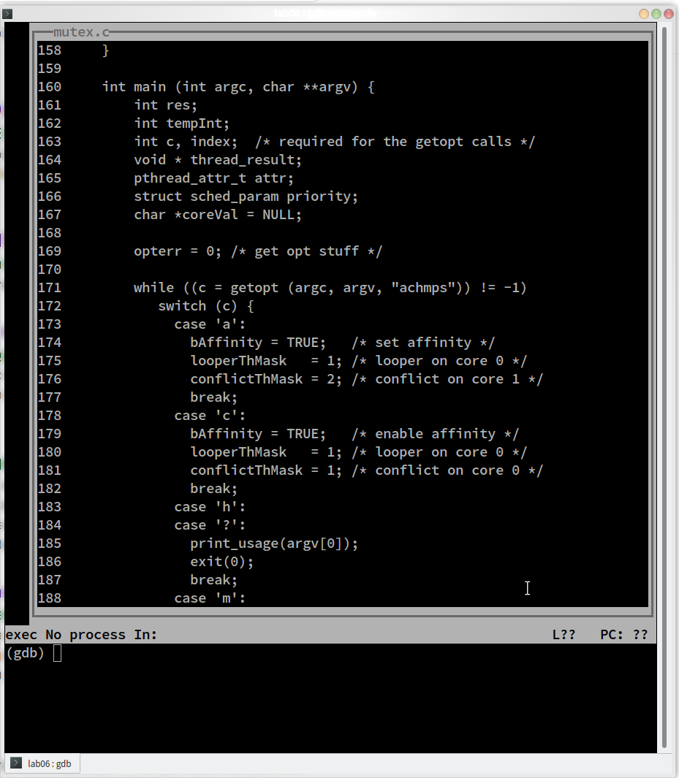
Running gdb in TUI Mode
TUI mode is a text-based user interface that separates out the program text from the gdb command line
Uses curses
More clear cut than using the typical CLI, but maybe not as good as the GUIs for gdb like ddd
You can start gdb in TUI mode using the --tui command line argument
You can switch in and out of TUI mode using <CTRL> X A keyboard sequence

Slide 10
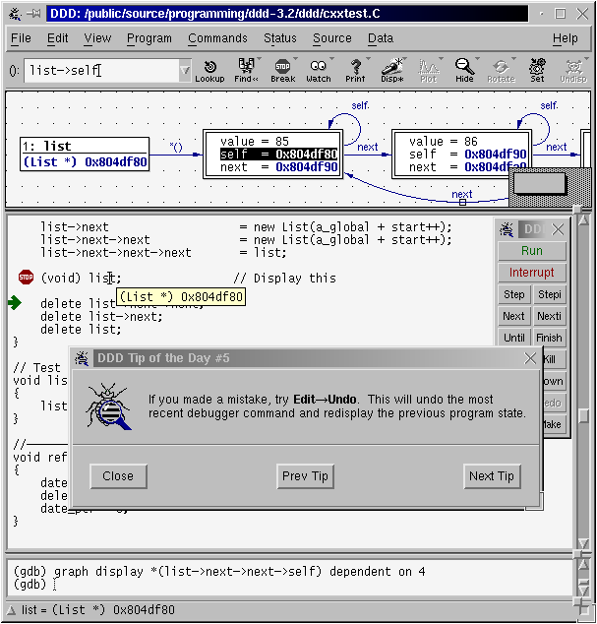
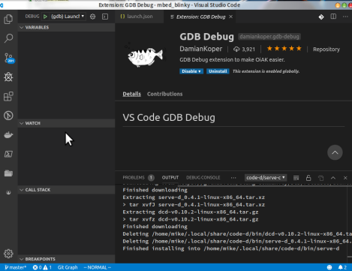
GDB GUIs
There are standalone and IDE-based front ends to gdb
These include:
ddd
Data Display Debugger
Also works with cross debugging
http://www.gnu.org/software/ddd/
MS Visual Studio Code
Yes, it’s OSS
GDB plug-in that enables graphical debug in IDE
https://code.visualstudio.com/download
IDE support includes Eclipse, Kdevelop, Slickedit®, CodeWarrior®, Arriba® and more

Slide 11
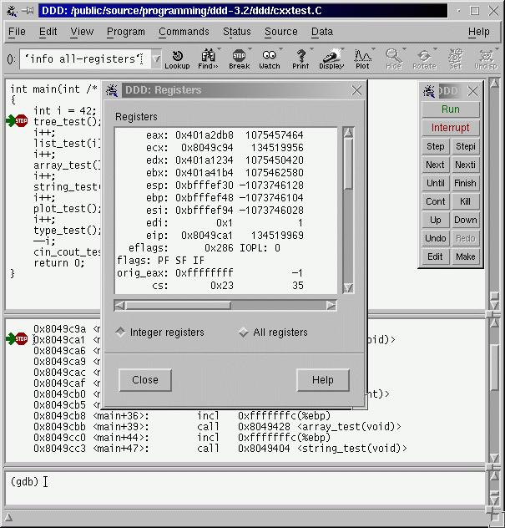
ddd Front End GUI
ddd is the GNU-supported graphical interface for gdb
ddd supports:
gdb, jdb, Python, Perl, TCL and PHP
You can automatically load the application into gdb at invocation
ddd can be started with the -debugger option to run a gdb backend other than the default gdb instance
$ ddd –debugger arm-linux-gnueabi-gdb myapp

Slide 12
Example Help Output
(gdb) help
List of classes of commands:
aliases -- Aliases of other commands
breakpoints -- Making program stop at certain points
data -- Examining data
files -- Specifying and examining files
internals -- Maintenance commands
obscure -- Obscure features
running -- Running the program
stack -- Examining the stack
status -- Status inquiries
support -- Support facilities
tracepoints -- Tracing of program execution without stopping the program
user-defined -- User-defined commands
Type "help" followed by a class name for a list of commands in that class.
Type "help all" for the list of all commands.
Type "help" followed by command name for full documentation.
Type "apropos word" to search for commands related to "word".
Command name abbreviations are allowed if unambiguous.

Slide 13
Command Definition and Macros
gdb has the ability to define your own commands/scripts
Use the define <name> command to define a sequence of gdb commands
Enter each one line-by-line and finish with a single line “end”
Useful for creating debugging command scripts that you can save for later use or just to save repeated typing
Use the document <name> to write documentation for your defined commands
Again, enter each one line-by-line and finish with a single line “end”
There is also the ability to define C/C++ preprocessor macros using the macro define command
Visible to all of the inferior’s source files

Slide 14
gdb Scripts
If it exists, gdb will execute all of the commands found in .gdbinit in the current directory
Useful for executing a sequence of gdb commands at gdb initialization:
set history save on
set print pretty on
set pagination off
set confirm off
The -x command line option to gdb also allows for running scripts at gdb load time
You can also define keyboard macros that launch python scripts or shell off to the OS using shell <cmd>

Slide 15
Embedded Python Engine
gdb now has a tightly integrated Python engine!
It doesn’t just shell out
Execute single Python expressions by prefacing the expression with “python”
Go into interactive mode by typing “python” and then remember to type “end” as the last line
(gdb) python gdb.execute() to do gdb commands
(gdb) python gdb.parse_and_eval() to get data from the inferior
(gdb) python help(‘gdb’) to see Python gdb package

Slide 16
Working with Signals via gdb
gdb is built on top of ptrace
When an inferior gets a signal, the inferior is suspended and the tracer gets notified
Show signals
(gdb) info signals
Prints a table of how signals and how gdb will handle each one
(gdb) info handle
Change the way gdb will handle the signal
nostop – do not stop the program but still print that signal occurred
stop – stop program when signal occurs (implies print as well)
print – print a message when signal occurs
noprint – do not mention the occurrence of the signal
pass – allow your program to see the signal so it can be handled
nopass – do not pass the signal to your program
(gdb) handle signal keywords
Delivers a SEGV signal to the current program
(gdb) signal SIGSEGV
Notes:
Handle SIGINT stop print pass
Pass the signal with continue

Slide 17
Load/Execute Your Code
If you don’t load the program from the command line, you can load additional files using the file <filename> command
Once the code is loaded into gdb, you can execute it using the run command
You can pass parameters in the same command or you can use the set args command
show args will allow you to see the arguments

Slide 18
Attach to a Running Program
gdb has the ability to attach to a running program
$ gdb –p <process id>
This will stop the running program at its current execution point
You can then load the executable’s code and symbol table using the file command to load the source if it hasn’t already been loaded

Slide 19
Examining Code
Once the program is loaded in gdb, you can list any of the source files using the list command
Options to list a LINENUM, FILE:LINENUM, FUNCTION, FILE:FUNCTION or *ADDRESS
You can specify the number of lines to list as a second parameter
Defaults to 10 but can be changed with set listsize <value>
You can change the options using the set command
E.g., set output-radix 16 would set the display radix to hexidecimal
Use show to see the available options
help set <option> to get help on the different options

Slide 20
Calling Functions Interactively
Once the code is loaded, you can actually call program functions from the gdb command line
The syntax and parameter passing is based on the language the code is written in
The function will be called and the return will be printed and saved in the value history

Slide 21
Setting Variables
You can define new variables, set a register value or modify program variables using the set VAR = EXP (or whatever the language equivalent is for your language)
Expressions are any valid expression for the language
You can set a variable that uses the same name as a gdb command using the set variable VAR = EXP syntax

Slide 22
Printing Expressions
Use the print EXP syntax to print any value from the current stack frame, globals or an entire file
Use $NUM to get the previous value of NUM
You can refer back farther using $$NUM
Registers are accessed using the $<REGNAME> syntax
{TYPE}ADREXP refers to datum of data type {TYPE} located at address ADREXP
The @ symbol is a binary operator for treating consecutive data objects anywhere in memory as an array
E.g., FOO@NUM gives an array whose first element is foo, whose second is stored in the memory adjacent to FOO, etc.

Slide 23
Examine Memory at Address
If we have a known address in memory, such as a pointer, we can display the memory at that address
We can also use a format character but x also adds an additional character to indicate the size of the display
Size letters are b(byte), h(halfword), w(word), g(giant, 8 bytes)
E.g., (gdb) x /db &test

Slide 24
Setting Breakpoints
gdb supports several types of breakpoint
Normal breakpoints b <lineno>
Temporary breakpoints tbreak <lineno>
Hardware breakpoints hbreak <lineno>
You can also set conditional breakpoints (beware of the overhead)
(gdb) break <lineno> if <condition is true>
You can issue commands to be run when the breakpoint is hit
(gdb) After b main
(gdb) commands
Type commands to be executed when breakpoint 1 is hit, one per line
End with a line saying just “End”
> silent
> printf “ main started\n”
> cont
> end

Slide 25
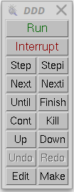
Stepping Through Code
gdb has a number of ways to step through the code after encountering a breakpoint
Step – step one line and step into functions
Next – step one line and step over functions
Finish – you stepped into a function accidentally and you want to finish this routine
Stepi – step one assembly language instruction and step into function calls
Nexti – step one assembly language instruction but step over function calls

Slide 26
Watchpoints
Force a program break when a selected variable’s value changes
Examples:
watch –l <address/symbol> command is scope aware
rwatch <a/s> stops if the address is read
watch <a/s> thread 3 stops if thread 3 modifies
watch <a/s> if <a/s> > 5 stops when contents > 5
Show old and new value and location in code that caused the change in value
(gdb) b main
(gdb) run
(gdb) watch x
(gdb) cont
Hardware watchpoint 2: x
Old value = 13451357
New value = 10
Main() at watch.c:10

Slide 27
Debugging Threads
Show active thread ids
(gdb) info threads
Select a thread by id
(gdb) thread n
Restrict breakpoint to a particular thread
(gdb) break <break ident> thread <id>
Not specifying a thread ID will cause the breakpoint to apply to all threads
Show backtraces for all threads:
(gdb) thread apply all bt
Restrict thread execution to current thread
(gdb) set scheduler-locking on | off
Source: optusnet.com.au

Slide 28
Generating “Core Dumps”
When an application terminates abnormally, a core file can be generated
core file - (n.) A file created when a program malfunctions and terminates. The core file holds a snapshot of memory, taken at the time the fault occurred. This file can be used to determine the cause of the malfunction
By default, this feature is disabled to preclude “core droppings” in the file system
Use: $ ulimit –c <max core file size in disk sectors> to re-enable core file generation
Source: heartrails.com

Slide 29
Using the Core File
Once you have a core file, you can use gdb to try to determine what went wrong
Load the core file using:
$ gdb <application name> -core <corefile>
gdb will load the application and will show you the point of failure
This will also work with most gdb front-ends
eclipse
ddd
Insight

Slide 30
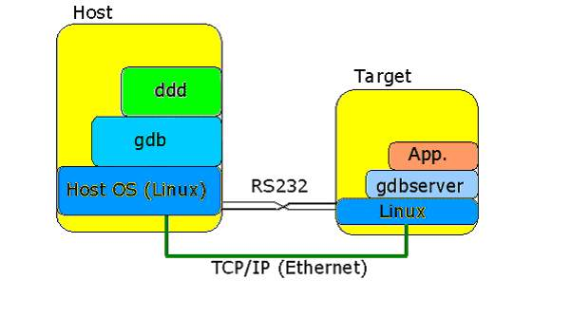
Remote Debugging with gdb/gdbserver
The DWARF debug format does not change because we’re using an alternate processor type
We will load the code to be debugged into the local gdb session and then connect with the remote gdbserver
Communications with the gdbserver helps keep the gdb session in sync
The application to be debugged runs under the control of the gdbserver application
Uses ptrace() functions to control starting and stopping of the target application
Source: codeproject.com

Slide 31
gdb/gdbserver Cross Debug Example
For example:
On the target:
$ gdbserver 192.168.7.1:1929 myapp &
On the host:
(gdb) target remote 192.168.7.2:1929
gdbserver can attach to a running program
$ gdbserver hostIP:2345 --attach PID
Works within GUI-based front-ends as well
You must tell gdb which back-end to use
$ ddd –debugger arm-linux-gnueabi-gdb myapp

Slide 32
strace/ltrace
Using tools like atsar, top, gkrellm, etc. will give you an idea as to what your system is doing globally. You can now focus on system call and library call tracing
strace and ltrace
These require no special compilation flags
They can be attached to a running application at any time
They support time tagging for crude performance monitoring

Slide 33
Using strace to Watch System Calls
When debugging what appears to be a kernel-space error, it can be helpful to watch the system calls that are made from user-space
See what events lead to the error
strace displays all system calls made by a program
Can display timestamp information per system call as well
Source: diy.despair.com

Slide 34
Example strace Output
/ # strace ls /dev/labdev
execve("/bin/ls", ["ls", "/dev/labdev"], [/* 8 vars */]) = 0
fcntl64(0, F_GETFD) = 0
fcntl64(1, F_GETFD) = 0
fcntl64(2, F_GETFD) = 0
geteuid() = 0
getuid() = 0
getegid() = 0
getgid() = 0
brk(0) = 0x1028ad68
brk(0x1028bd68) = 0x1028bd68
brk(0x1028c000) = 0x1028c000
ioctl(1, TIOCGWINSZ or TIOCGWINSZ, {ws_row=0, ws_col=0, ws_xpixel=0, ws_ypixel=0
ioctl(1, TCGETS or TCGETS, {B9600 opost isig icanon echo ...}) = 0
ioctl(1, TCGETS or TCGETS, {B9600 opost isig icanon echo ...}) = 0
lstat("/dev/labdev", {st_mode=S_IFCHR|0644, st_rdev=makedev(254, 0), ...}) = 0
open("/etc/localtime", O_RDONLY) = -1 ENOENT (No such file or directory)
lstat("/dev/labdev", {st_mode=S_IFCHR|0644, st_rdev=makedev(254, 0), ...}) = 0
fstat64(1, {st_mode=S_IFCHR|0600, st_rdev=makedev(4, 64), ...}) = 0
ioctl(1, TCGETS or TCGETS, {B9600 opost isig icanon echo ...}) = 0
mmap(NULL, 4096, PROT_READ|PROT_WRITE, MAP_PRIVATE|MAP_ANONYMOUS, -1, 0) = 0x300
write(1, "\33[1;35m/dev/labdev\33[0m\n", 23/dev/labdev) = 23
munmap(0x30000000, 4096) = 0
Exit(0) = ?

Slide 35
strace – Where is time being spent?
Use –c option while invoking the app
Example – v4l2-based application
$ strace -c ./capture_stream -D /dev/video0 -w 640*480 -p 1|./viewer -w 640*480 -p 1
% time seconds usecs/call calls errors syscall
------ ----------- ----------- --------- --------- ----------------
86.40 0.054382 365 149 write
9.53 0.005999 41 148 select
3.85 0.002425 8 310 2 ioctl
0.21 0.000133 10 13 mmap
0.00 0.000000 0 1 read
0.00 0.000000 0 3 open
0.00 0.000000 0 2 close
0.00 0.000000 0 1 stat
0.00 0.000000 0 3 fstat
0.00 0.000000 0 4 mprotect
0.00 0.000000 0 1 munmap
0.00 0.000000 0 3 brk
0.00 0.000000 0 3 3 access
0.00 0.000000 0 1 execve
0.00 0.000000 0 1 arch_prctl
------ ----------- ----------- --------- --------- ----------------
100.00 0.062939 643 5 total
Most of the time is consumed in the write call

Slide 36
ltrace
Just as strace allows us to trace system calls, ltrace allows us to trace library calls
You do not have to have the source nor compile the library for debugging to do this
Can be used to trace glibc interaction
But be prepared to get a *lot* of output
Command-line options exist to limit which libraries you are interested in tracing
Other options are similar to strace
The output looks like strace

Slide 37
Procfs
Procfs is a representation of the kernel’s information about each process/thread and about the system itself
Each process ID has its own directory with information about memory usage, processor affinity, child threads and more
Many system tuning parameters for the protocol stack and interrupts are here as well

Slide 38
What is Valgrind?
Valgrind is an instrumentation framework for building dynamic analysis tools
Built to be user extensible
It is widely used by Linux developers
Valgrind tools can automatically detect potential memory management and threading problems
Has tools for providing profiling data
Mainly supports C and C++ programs
Licensed under GPL v2
Documentation is at http://valgrind.org/doc
Source: valgrind.org

Slide 39
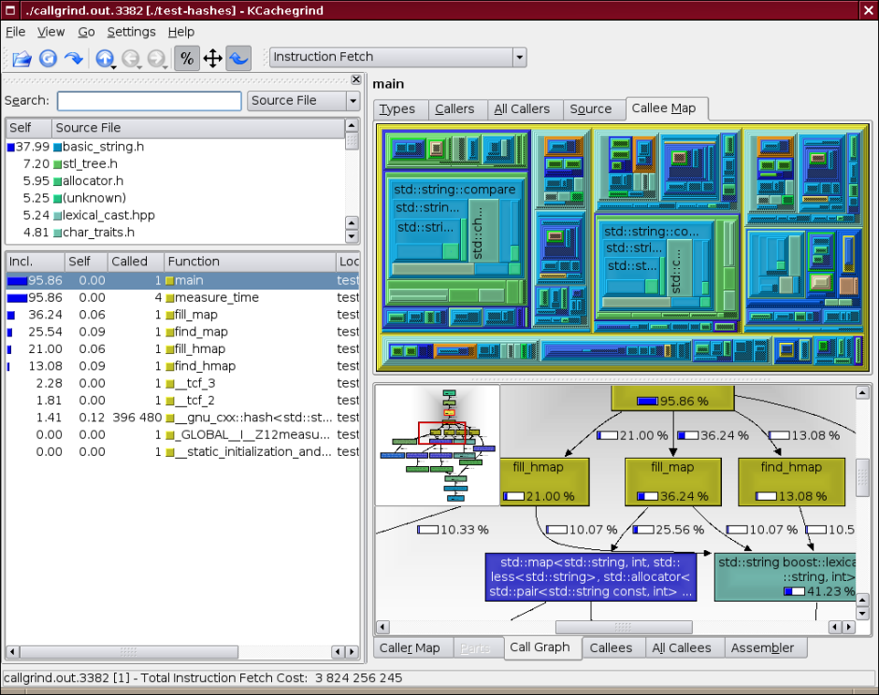
Valgrind
Collection of user-space analysis tools
Embedded options are now available for PPC and ARM
Traditionally built and run under x86 for analysis then transfer to target
Memcheck – memory leaks etc.
Cachegrind – cache and locality of reference
Callgrind – caller/callee relationships
Massif – heap profiler
Helgrind – POSIX threads helper
DRD – Multi threaded C/C++ detector
$ valgrind –vgdb=full -–vgdb-error=0 ./prog
Runs gdb server inside of Valgrind that you can connect remotely to
Source: alexott.net
Notes:
39
Gcc –g –fsanitize=address –static-libasan out_bounds.c AddressSanitizer, MemorySanitizer, ThreadSanitizer, LeakSanitizer
Record
Reverse-stepi

Slide 40
Zooming in on User Space: gprof
gprof is included as part of the GNU utilities
The GNU compiler instruments your code to collect execution information
Compile the code with the -pg compiler flag
Then run the application to collect the information
Make sure that the application exits properly
Compile the code with the -pg compiler flag and run it
$ gcc -o myprog myprog.c utils.c -g -pg
Then run gprof:
$ gprof options [executable file [profile data file]]
The options control the type of output that gprof produces, possible symbols to ignore, etc.
The resulting gmon.out file contains the profiling information
Viewable as a flat output, call graph or annotated source

Slide 41
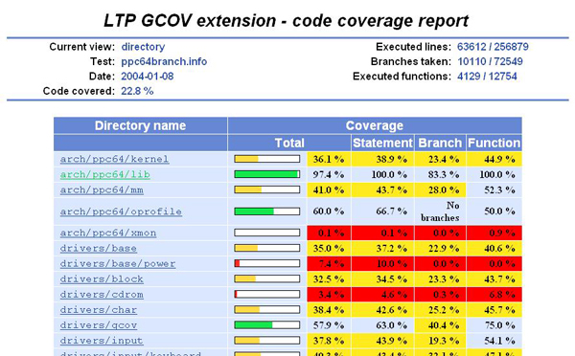
Profiling Via Code Coverage
Another possibility is that your code has different use cases
Being able to tell what code actually ran can help zero in on specific test cases
To help with this, the GNU tools have gcov
The GNU code coverage tool
Requires the -fprofile-arcs –ftest-coverage compiler options
Produces an output file with the source annotated with how many times each line of code was executed
Source: ibm.com

Slide 42
Example gcov Execution
$ gcc -fprofile-arcs -ftest-coverage tmp.c –o tmp
$ ./tmp
$ gcov tmp.c
90.00% of 10 source lines executed in file tmp.c
Creating tmp.c.gcov.
-: 6:
1: 7: total = 0;
-: 8:
11: 9: for (i = 0; i < 10; i++)
10: 10: total += i;
-: 11:
1: 12: if (total != 45)
#####: 13: printf ("Failure\n");
-: 14: else
1: 15: printf ("Success\n");
1: 16: return 0;
1: 17:}
The number on the left indicates the number of times that line was executed
The ##### indicates a line that was not executed

Slide 43
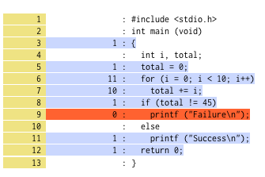
Branch Annotated Source
The annotated source code would then look like:
-: 0:Source:tmp.c
-: 0:Object:tmp.bb
-: 1:#include <stdio.h>
-: 2:
-: 3:int main (void)
1: 4:{
1: 5: int i, total;
-: 6:
1: 7: total = 0;
-: 8:
11: 9: for (i = 0; i < 10; i++)
branch 0: taken 90%
branch 1: taken 100%
branch 2: taken 100%
10: 10: total += i;
-: 11:
1: 12: if (total != 45)
branch 0: taken 100%
#####: 13: printf ("Failure\n");
call 0: never executed
branch 1: never executed
-: 14: else
1: 15: printf ("Success\n");
call 0: returns 100%
1: 16: return 0;
1: 17:}
Source: postography.com

Slide 44
LTTng 2.x
“Linux Trace Toolkit – next generation”
Traces both user and kernel events
Can be used as a fast strace replacement
Gathers from multiple sources
Tracepoint, kprobes, perf monitors for kernel
Supports instrumentation in user and kernel space
Outputs to a common format
Supports the “Common Trace Format” (CTF)
Multiple viewers will be able to read output
Babeltrace, Eclipse LTTng plugin (currently available)
LTTV Viewer, (work in progress)
Source: lttng.org
Notes:
Note: As of August, 2012 work was still ongoing to convert LTTV Viewer over to CTF.

Slide 45
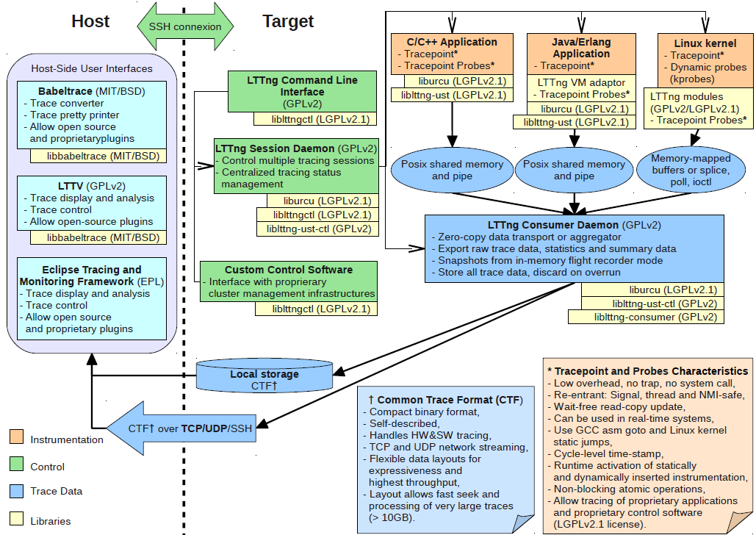
LTTng Tracer Architecture
Source: lttng.org

Slide 46
LTTng-UST
LTTng-UST (User Space Tracer) designed to provide detailed information about user space activity
Port of the LTTng kernel tracer to user space
Tracing does not require system calls or traps
LTTng-UST instrumentation points can be added in applications including signal handlers and libraries

Slide 47
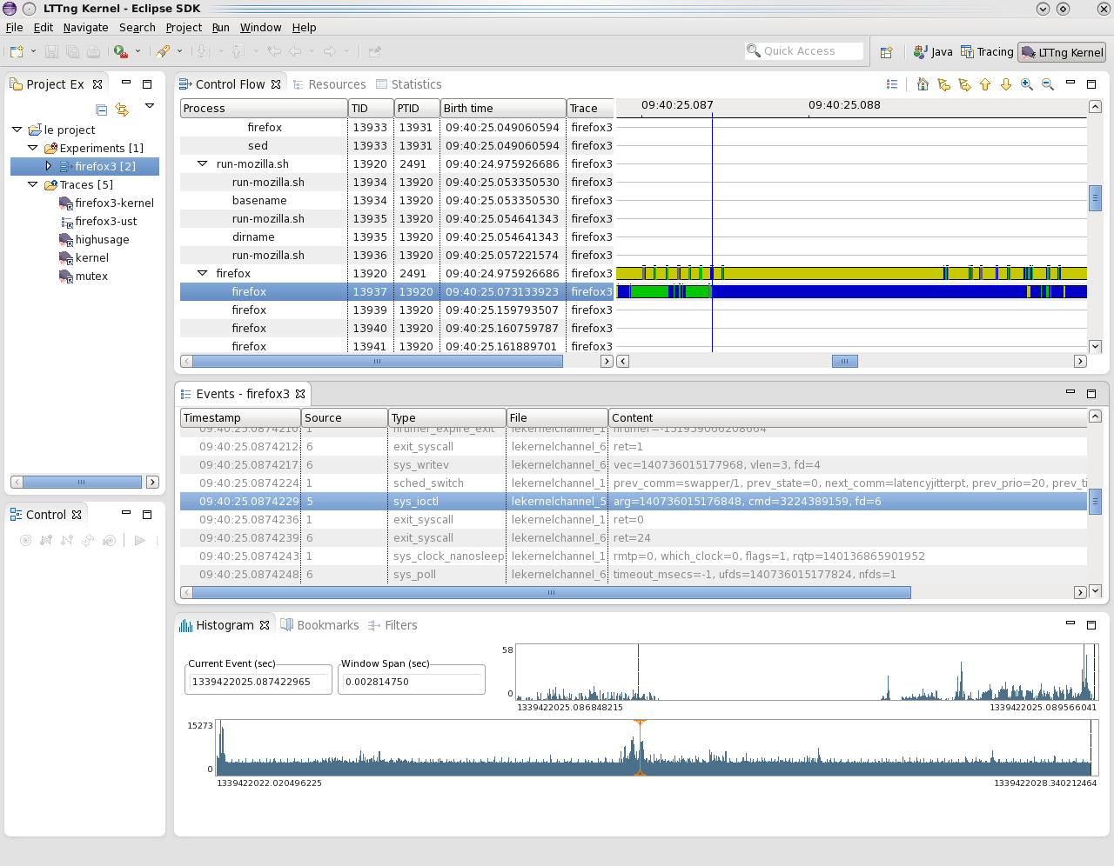
LTTng Eclipse Plug-in

Slide 48
OProfile
OProfile is a kernel-based, statistical profiler
Samples instruction pointer to figure out what’s running
Records current symbol and owner task
Can also track cache misses
Must be enabled in the kernel and rebuilt
It’s useful for seeing where in the kernel your applications are spending their time
There is a collection of userspace helpers that help control and display the OProfile data
Notes:
48

Slide 49
OProfile Sample Output
The OProfile data capture is made available via a /proc entry
The opreport command reads the data and creates a report
samples % app name symbol name
10469 34.0146 no-vmlinux (no symbols)‏
4358 14.1595 libxul.so (no symbols)‏
4306 13.9905 libmozjs.so (no symbols)‏
3000 9.7472 libc-2.8.90.so (no symbols)‏
1185 3.8502 libglib-2.0.so.0.1800.2 (no symbols)‏
895 2.9079 libflashplayer.so (no symbols)‏
626 2.0339 libpixman-1.so.0.12.0 (no symbols)‏
588 1.9105 libnspr4.so.0d (no symbols)‏
468 1.5206 bash (no symbols)‏
457 1.4848 libpthread-2.8.90.so pthread_mutex_lock
454 1.4751 Xorg (no symbols)‏
401 1.3029 fglrx_dri.so (no symbols)‏
Notes:
49

Slide 50
What is Ftrace?
Ftrace (function tracer) was developed largely by Steven Rostedt and a few other key kernel developers
The primary focus was embedded Linux and the PREEMPT_RT real-time patches in the kernel
Ftrace was introduced into the kernel in 2008 as a way of providing debugging info
Allowed for time stamps, calling hierarchies and more
Well beyond the typical printk()
The documentation was actually in the kernel before the code!
Source: facesofopensource.com

Slide 51
What is Ftrace? #2
ftrace provides tracing for internal kernel operations
Static tracepoints via event tracing for
interrupts, scheduling, file systems and more
Latencies for interrupts, preemption and combined
Process wakeup latencies with filtering for RT processes
Dynamic kernel function tracing
Tracing any function within kernel
Function filtering
Call graphs
Stack usage and frames
Many more tracepoints
ftrace is a feature consolidated tool based or prior tracing facilities in the kernel
Like OProfile, ftrace must be enabled in the kernel

Slide 52
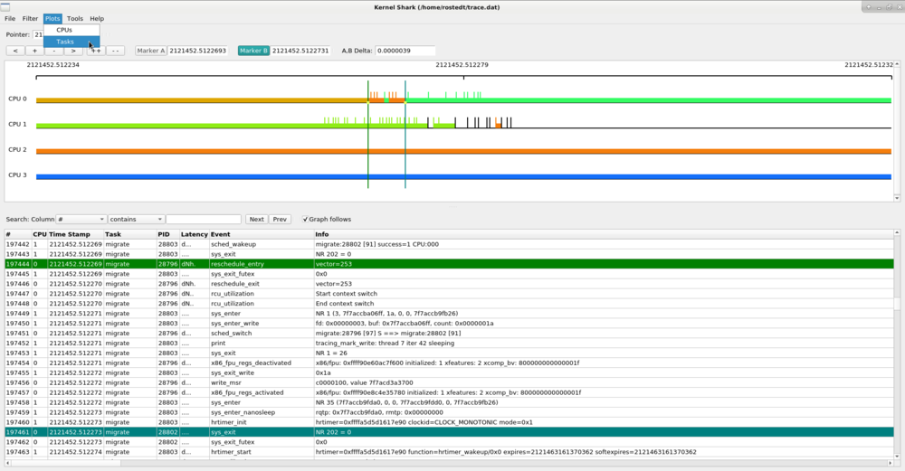
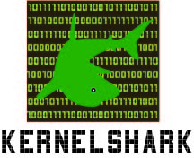
Graphing the Data via Kernelshark
kernelshark is a GUI that reads and plots the data from ftrace
Graphical output that is easy to include in reports
Kernelshark v1.0 is now out!
Based on Qt instead of original GTK version
Source: kernelshark.org

Slide 53
Summary
The problem with Linux is not that there aren’t enough tools, but there are too many
Some overlap as well
Debugging is at least mostly done with gdb
However, never underestimate the power of a lowly LED and an oscilloscope
gprof/gcov and strace/ltrace provide additional insights
Then, ftrace/LTTng can show additional interactions with kernel space for a system-wide view

